Slide 1
Diffusion Models in Singapore Schools: Dialectics of Centralization and Decentralization
AERA 2015
David Hung and Paul Chua
National Institute of Education
Nanyang Technological University

Slide 2
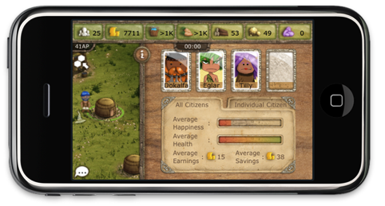


Inquiry Pedagogies (system change)
21st Century learning practices enacted (OER)
Social studies inquiry
Knowledge building
Seamless learning
Productive failure
Problem solving
Non linear Pedagogy
Game based learning
Six Learnings
Others
HA
MA
LA
clusters
resources
schools
assessment
Learning design
classrooms
curriculum
individuals

Slide 3
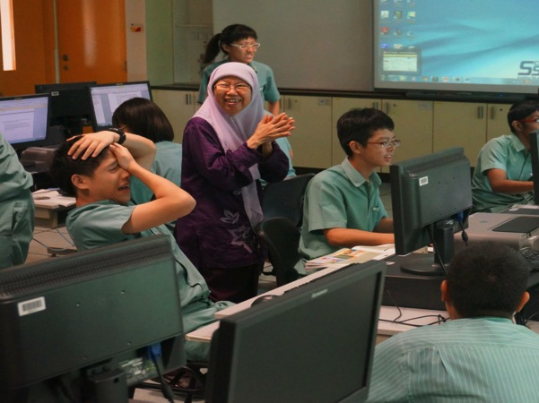
Teachers’ shift in epistemological stance
“… the classroom environment is different…it is noisy. My students are asking questions … My role as teacher changes …I can say I don’t know and encourage students to find out…” (teacher)

Slide 4
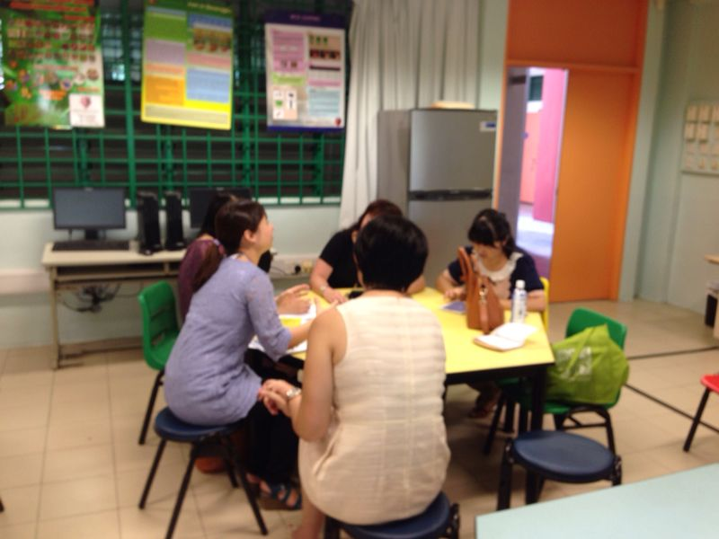
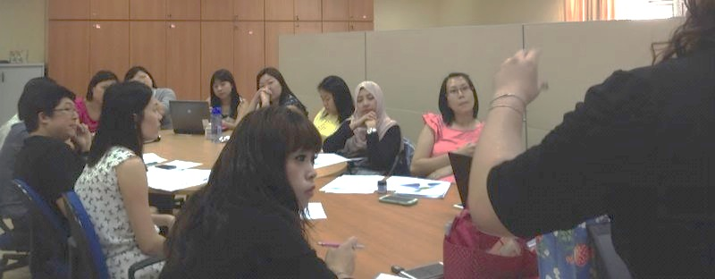
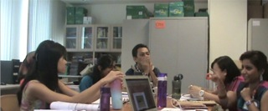
School based …
Peer Apprenticeship Learning (Hung, 1998)
“…Every week, we have timetabled time. We co-design lesson plans. We think about the kinds of learning activities and objectives for different students (low, middle, and high ability students)… We discuss how we are going to conduct lessons for the week. We share with colleagues the problems we face and make improvements for next year’s lesson plans…” (teacher)

Slide 5

Socio-Technological Infrastructure (Depth)
Goals/vision
Dialogue/interpretation
Curricular adaptations
Emergence in contexts
Leadership support
Learning culture
Teacher peer support group
Teacher experimentations

Slide 6
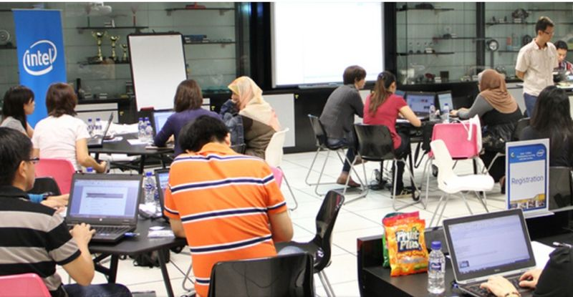
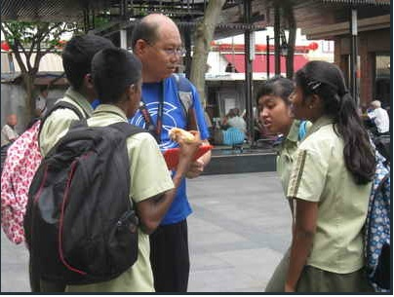
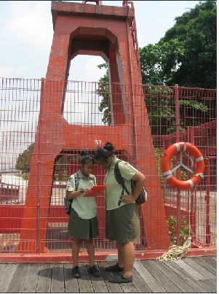
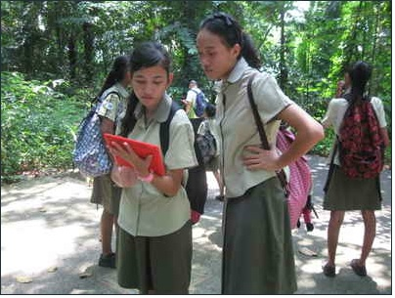
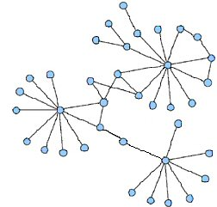
Cluster based …
S2 Cluster
CRADLE
NiTC Competitions

Slide 7
Socio-technological infrastructure (breath & depth)
MOE’s policies
Cluster of schools
Learning Community
Teacher Leaders
National Institute of Education
Optimization of resources and expertise
Authentic opportunities for inquiry based enactments
School’s learning culture for innovations
Alignments of teacher needs and school’s goals
Lateral networks
Expertise and epistemic change development

Slide 8
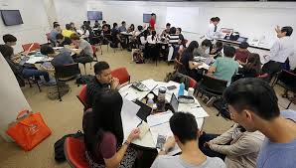

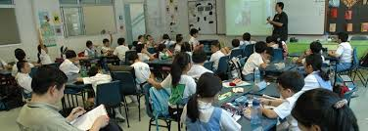
System based …
Learning Communities and National Institute of Education
with supporting socio-technological infrastructure
Equipment/Resources
Legitimized time
Peer support group
Teacher Leaders
Teacher’s actual classroom enactments in schools

Slide 9
Socio-Technological Infrastructure (breath & depth?)
Curricular resources accessible at
cluster/system level
Adaptations and re-contextualizations
Core Theory
Repertoire of case examples
Curriculum resources
Socio-Technological Infrastructure
Building school based community
Linking up to cluster/system level communities

Slide 10
Key observations …
Non one size fits all
  Not all innovations require the same depth and breadth of innovation reach
  Innovation should be situated at the appropriate level
Socio technological infrastructure
  Fostering a culture of learning
  Optimization of resources and capacity-expertise is required in lieu of research funding
  Alignments across levels (MOE, clusters, schools, classrooms)
Teacher Champions/Leaders
  Without a strategy for developing teacher leaders, no sustainability is possible
  Deployment to be more strategic
  There is a need to move towards increasing laterality

