Slide 1
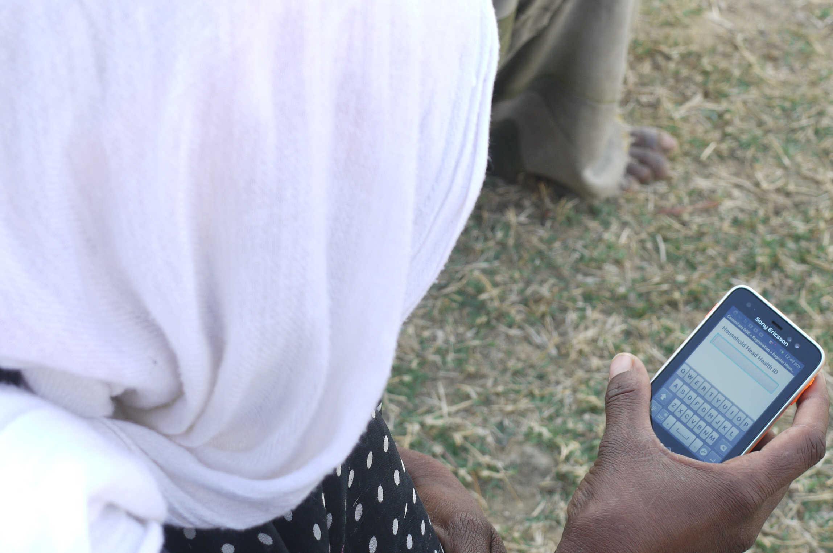

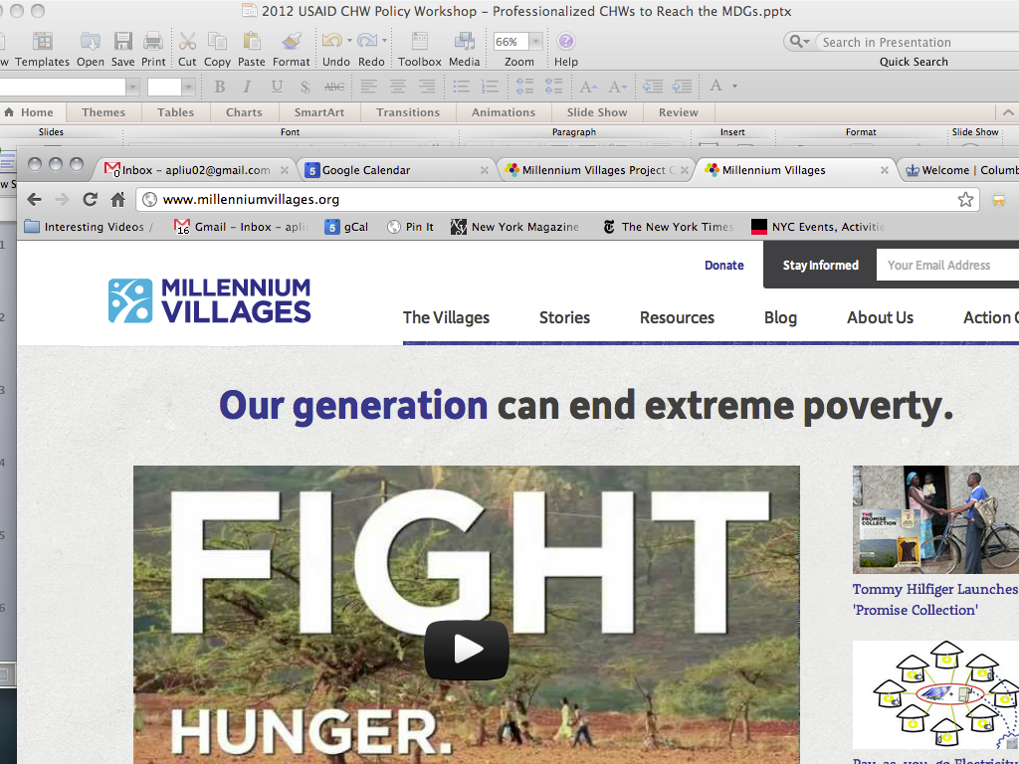
REAL-TIME ACCESS AND
UTILIZATION OF CHILDREN’S
LEARNING DATA:
Case study from the
Millennium Villages
Project
Radhika Iyengar
AERA, April 2015

Slide 2

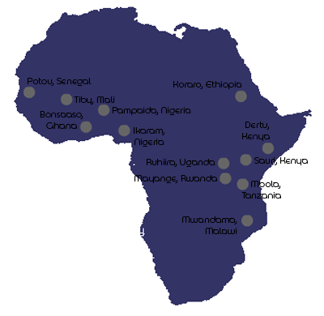
MVP works across 10 countries in sub-Saharan Africa
Rural remote village clusters
Inter-sectoral approach between health, education, agriculture, business development, infrastructure, etc.

Slide 3




Schools
MVP
Community
government
Gather data from schools (monthly)
Share results with stakeholders (community & government)
Government, community, & MVP can work with schools to address gaps (local solutions)

Slide 4

Why mobile technology?
Faster Results Faster Data Utilization
Faster Remediation/Action
- NO manual data entry or cleaning
- NO stacks of paper to carry

Slide 5
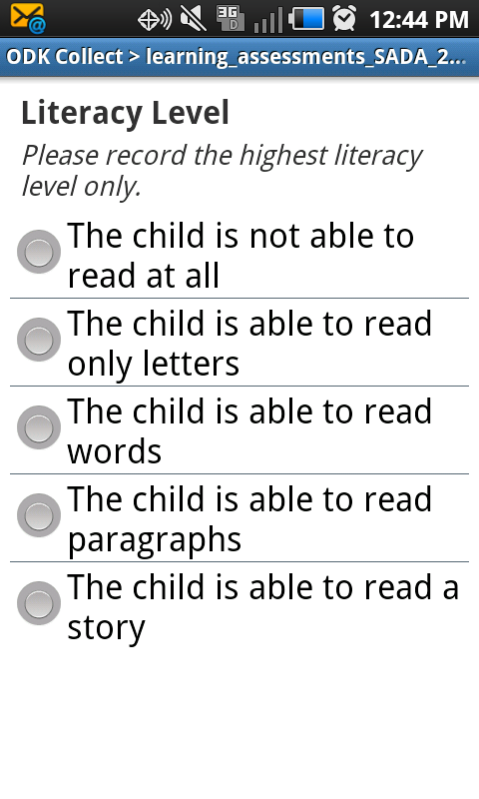

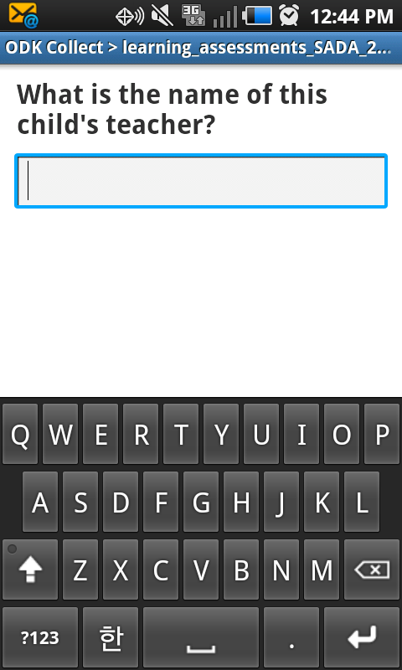
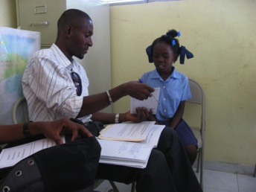
formhub:
Open source data collection platform used with mobile phones

Slide 6
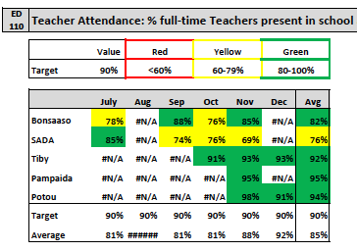
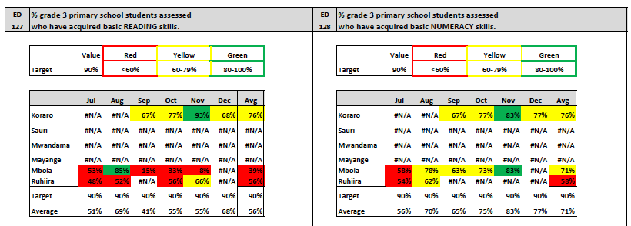
What data is gathered?
Key indicators include
  Student attendance
  Teacher attendance
  Infrastructure
  Materials & supplies
  Learning assessments
Notes:
Borrowed from the methodology of ASER/UWEZO
Gather other data on school conditions, materials, attendance etc. to put learning levels into context

Slide 7
Indicators by Frequency
Annually:
    Level of education offered (Pre-primary, primary…)
    Classrooms needing major repairs
    Percentage of teachers with minimum teaching certification required
each School Term:
    Percentage of teachers who have attended training
    Adequacy of school supplies
    Availability of textbooks
each month:
    Student attendance
    Teacher attendance
    Student learning outcomes
Notes:
Annual: They are not likely to change throughout the school year
ST: They may change throughout the school year, but not very frequently
Monthly: They change frequently and monitoring them regularly ensures quicker response time to issues raised in the data

Slide 8
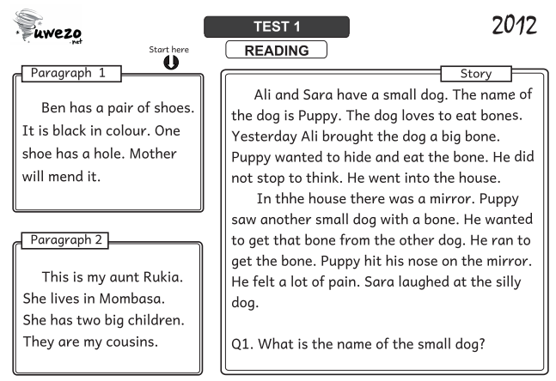
Learning assessments
Borrow from the ASER/UWEZO framework
Simple tests to measure if students can read, letters, words, paragraphs, or stories (literacy)
Numeracy tests include number recognition, addition, subtraction, multiplication, division etc.
Can be conducted 10 min per child

Slide 9
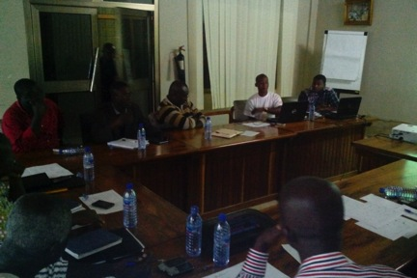
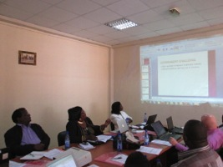
Putting Learning into perspective
Looking at learning levels
Also looking at school context
  Attendance
  Materials
  infrastructure
Using the data in meetings with government to plan remediation

Slide 10
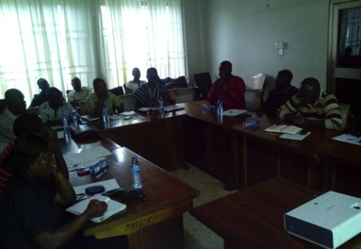
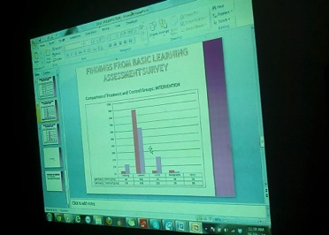
Information Sharing Meeting: Ghana
PARTICIPANTS: Ghana Education Services, members of Literacy Improvement Committee, and MVP team
OBJECTIVE: The main objective of the meeting was to share with the stakeholders what the situation is in relation to the literacy levels in our school children as has been revealed by the outcome monitoring results

Slide 11
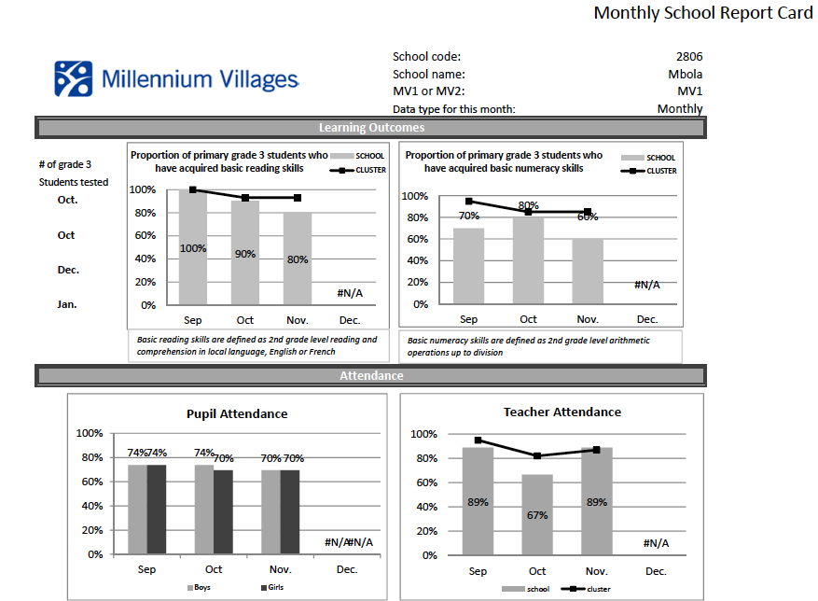
How is learning assessment data being used?
Tanzania:
  “MVP education cup” for schools to compete on best literacy/numeracy rates and student/teacher attendance

Slide 12
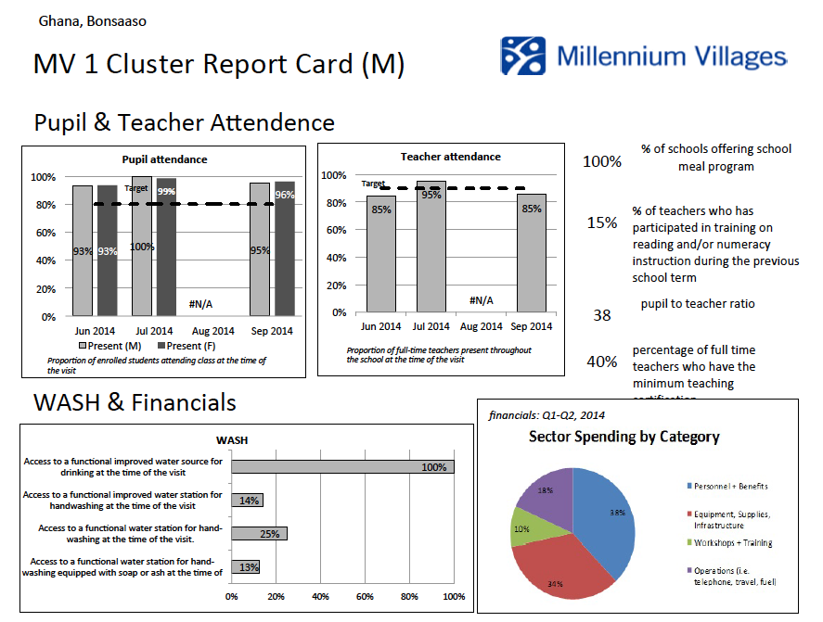
How is learning assessment data being used?
Rwanda:
  Share with education stakeholders during monthly meetings
  Plan to print posters and translate content into local language for community notice boards
Uganda:
  Share info with district education officers to have school inspectors sent to lower performing schools

Slide 13
Sharing Learning Assessment Results
Nigeria:
  Monthly meetings in schools (headmaster, teachers, attendance and enrollment issues discussed)
    Meeting 2x per month (PTAs, government inspectors in areas)
Senegal:
  Idea:
  To display data esp. on teacher attendance in weekly markets (since government offices are far, good to know community is involved and watching)
    To be followed up with monthly meetings on the results involving stakeholders
    Village chief/head to be involved as well for accountability (and oversight of teachers and absences)

Slide 14
Digesting the Learning Assessment Data
Learning Assessment Data
government
schools
community
Stakeholders & partners
MVP
Learning assessment data is gathered and shared for all relevant stakeholders to work to improve learning outcomes of children

