Slide 1
How Do School Sites Support the Adoption of Educational Innovations in the Finnish Context?
Jari Lavonen, Tiina Korhonen, & Kalle Juuti
Department of Teacher Education, University of Helsinki, Finland
Jari.Lavonen@Helsinki.Fi

Slide 2

I have designed with other teachers, pupils and out-of-school collaborators a new model for School-Community Collaboration (SCC) that engages primary pupils in SCC.
SSC creates learning environments for creative use of ICT.

Slide 3
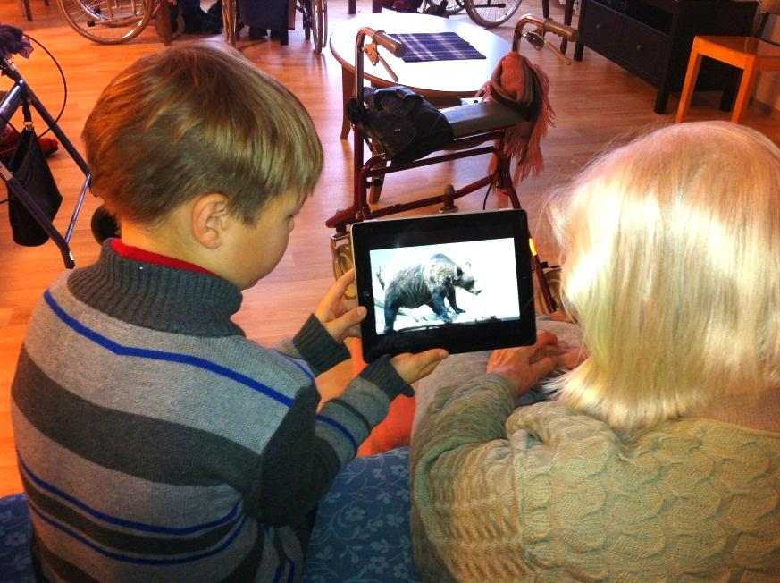

Slide 4

Values and Aims of an Innovative School
Professional teachers
Knowledge base
Collaboration
Life-long learning
Local curriculum
and
environments
Broad aims
Learning
environments
Leadership and
quality culture
Goal orientation and interaction
Quality culture
Networks &
partnerships
Design and adoption of educational innovations
Finnish
society
Partners
Global
Stakeholders
Parents
Diverse learners
A Finnish school

Slide 5



How teachers experience their professionalism in the context of innovative school?
In our school, teachers have versatile subject and pedagogical knowledge.
We share experiences and know-how in pedagogical coffee meetings.
Teachers are eager to develop their own work and interested about new innovations.
It is important to learn to use new technology continuously together with other teachers.

Slide 6
Individual characteristics of professional teacher (+ school level factors + cultural and education policy factors)
(Hargreaves & Goodson, 1996; Evans, 2008; Freidson, 2001; Urban & Dalli, 2011; Evetts, 2012)
The professional (conceptual) knowledge base
Self-regulation of and -control over the work (self-assessment).
Specific professional ideology, incl. shared understanding of professional values and ethics code .
Include social and individual elements
Strong institutionalization of an occupational group.
Autonomous role in planning and implementation.
Work (activities) is complex and not easy to standardize.
knowledge
base
networks &
partnerships
life-long-
learning

Slide 7
How teachers experience leadership?
You can recognise goal orientation in the operations of the school.
Interaction is organised through …
Openness and informing of forthcoming issues is important. … The strength in leadership is shared leadership.
The teachers and the principals should share a common vision … versatile collaboration support the adoption ….
Close to transformational leadership
(Marks & Printy, 2003; Huber & Muijs, 2010)

Slide 8
A teacher leader
(Lieberman, 1992, Harris, 2003)
is goal oriented
can plan, implement and assess his/her own practice and students’ learning
has deep understanding on teaching and learning
is able to work collaboratively with other teachers
is a facilitator, coach, mentor or a trainer of other teachers
is able to consume research based knowledge
Is a curriculum specialist and innovator for new approaches
is able to use assessment outcomes for school development.
…
knowledge
base
networks &
partnerships
life-long-
learning

Slide 9
How teachers experience learning environments?
More we have technology and resources, more we need co-planning, organising and support
It is important there are versatile learning spaces where students are able to engage in learning alone or in a small group. We need to design new environments.
It is important the teachers share a common goal on the use of technology in teaching and learning and support each other to approach these goals

Slide 10
How teachers experience networks and partnerships?
Networks and partnerships support communication in levels:
- school level (grade level and leadership teams);
- city level (thematic networks, principal networks);
- school-family-society partnerships;
- national level networks.
The use of technology supports networking
The networking should start from our needs – not coming as orders from the city level.
In order to support adoption …
School-family collaboration is organised through parents’ clubs & classroom committees.

Slide 11
Which school level factors support the adoption of educational innovations?
Teacher professionalism
depends on:
- 1. teacher knowledge base,
2. partnerships, 3. life-long-learning
  - school level factors
  environments, leadership, collaboration
  - cultural and education policy
  factors
Factors influencing the design and adoption of educational innovations:
- properties of the innovation
- local characteristics
- external factors (policy,
culture,)
Teacher leadership + Transformational leadership:
1. teacher knowledge leader base
2. networks & partnerships
(collaboration, facilitator)
3. life-long-learning (consume
research based knowledge;
reflection)
Innovative school is supportive for communication:
- characteristic of leadership
and professionalism,
- networks and partnerships.
11

Slide 12



Thank you!

