Slide 1

Bringing Effective Pedagogical Innovation to Scale through Social Movement in Mexico and Colombia
Santiago Rincón-Gallardo
OISE, University of Toronto
@SRinconGallardo

Slide 2

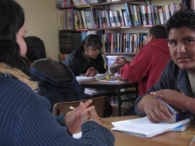
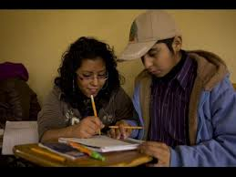
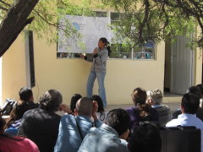
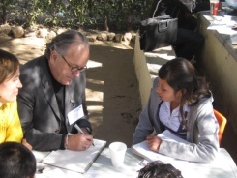
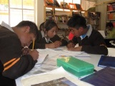

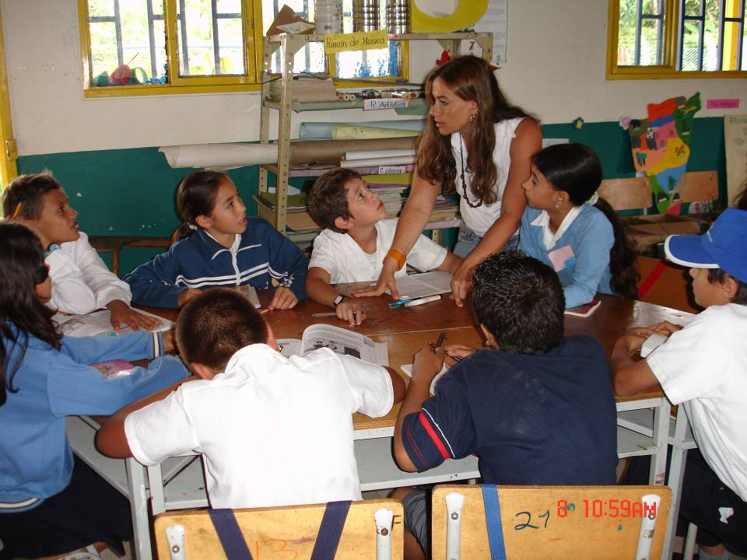
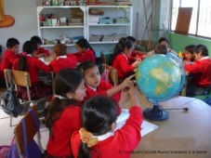
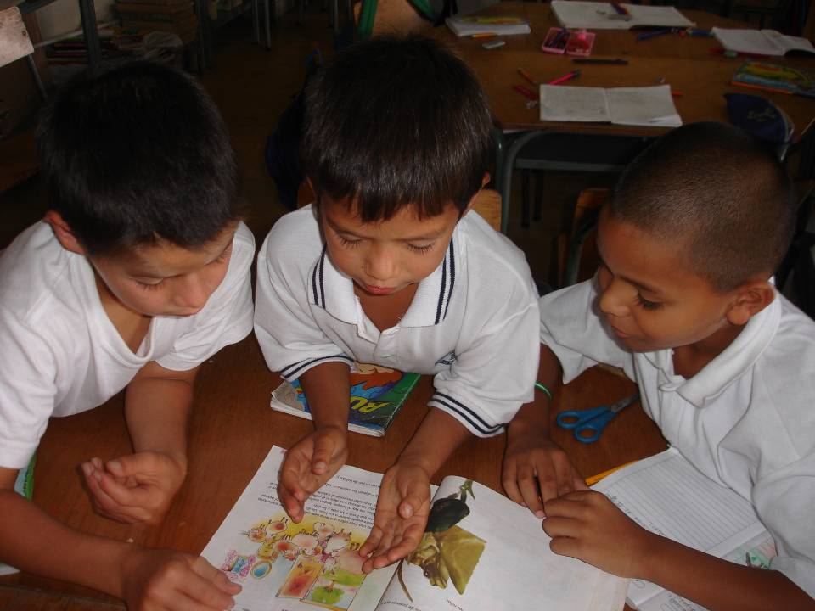
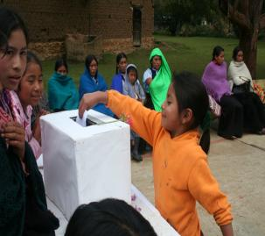
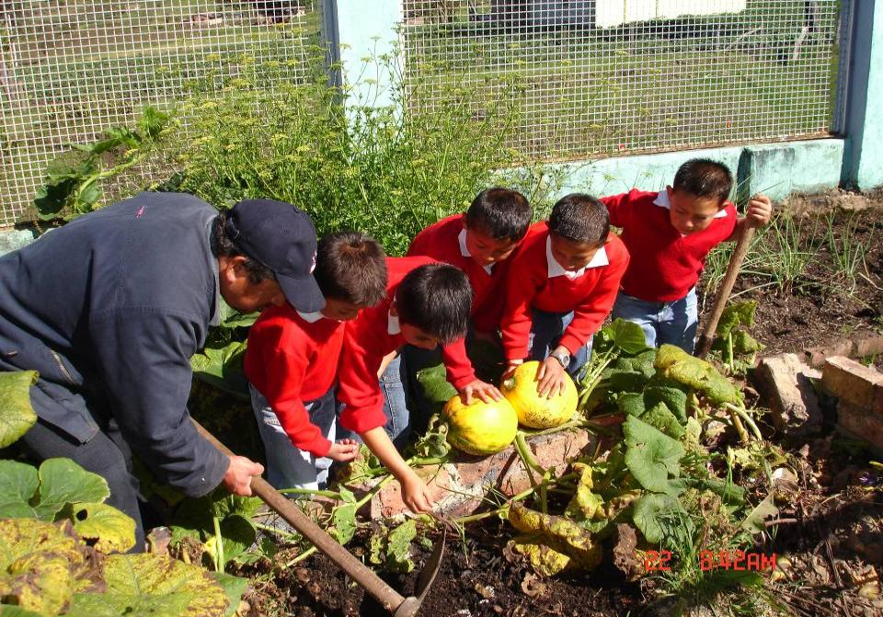
Learning Community Project
Percentage of students achieving “good” and “excellent” levels
Math
Language
LCP in Operation
NO LCP
www.redesdetutoria.org
Source: Dirección General de Desarrollo de la Gestión e Innovación Educativa (2012) Análisis de impacto del PEMLE en secundarias: Resultados prueba ENLACE..
Student achievement in Latin America: Rural vs Urban
Escuela Nueva
260
Cuba
255
250
Colombia
Argentina
Brasil
245
Promedio
Chile
Puntaje rural
240
República
México
235
Dominicana
Paraguay
230
225
Venezuela
Bolivia
220
Honduras
230
235
240
245
250
255
260
265
270
275
280
www.escuelanueva.org
Source: UNESCO (1999) First Comparative International Study on Quality of Education.

Slide 3

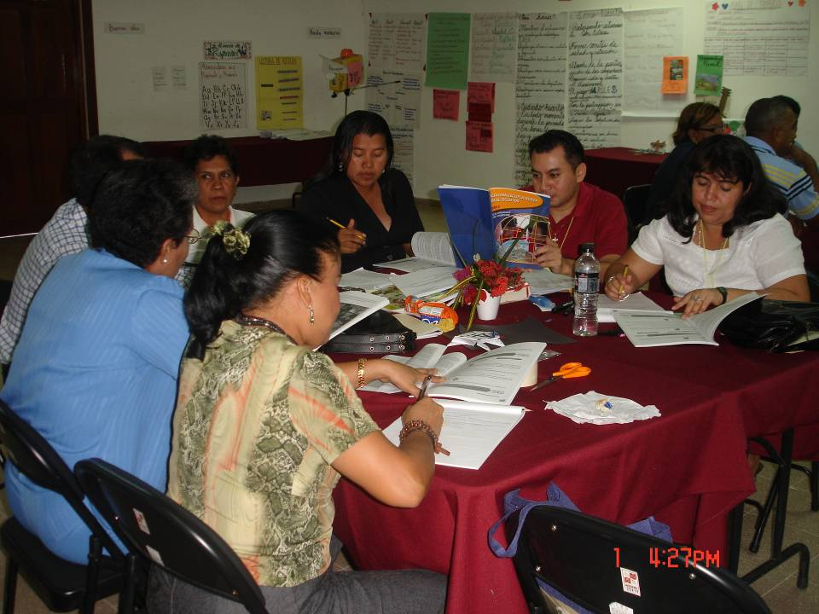
Start in the margins
Directly transform the instructional core
Get support of local education authorities
Create multiple opportunities to observe, practice and refine the new pedagogy
Link design and execution
content
teacher
student
POLICY
PRACTICE

Slide 4


Thank you!
santiago.rincon.gallardo@utoronto.ca
@SRinconGallardo
http://utoronto.academia.edu/RinconGallardoSantiago

